Slide 1
Studio multicentrico sul reintervento per recidiva di GBM:
ruolo del team multidisciplinare nell’indicazione e fattori predittivi di outcome
Reoperation is an established option for recurrent GBM.
Several prognosticators of good outcome after reoperation have been proposed.
Indication is generally discussed in the multidisciplinary board. However, few data are available on the role of board in improving prognosis.

Slide 2
Study proposal
Retrospective study (5-10 years)
Primary Endpoint:
Group 1: reoperation based on board decision
Group 2: reoperation based on single surgeon/neuro-oncologist decision
Estimated OS-12:
Group 1: 50%
Group 2: 25%
Historical OS-12 ratio in the lomustine arm of EORTC 26101 trial: 34.1%
Allocation Ratio 2:1
Requested sample size: 108 pts
Inclusion /Exclusion criteria
Recurrent GBM, IDH-wt after surgery and chemoradiotherapy
No needle biopsy
At least concomitant chemoradiation completed
Histopathological confirmation of recurrence
No age limitations
No KPS limitations

Slide 3
Secondary Endpoints
Patient
Age
KPS
Time to recurrence
Surgery
Surgery for first vs subsequent recurrences
EOR at first surgery
EOR at second surgery
Intraoperative fluorescence (5-ALA, fluorescein)
Tumor
Location (eloquent vs non-eloquent)
Molecular features (MGMT, EGFR, other)
Other? Input welcome

Slide 4
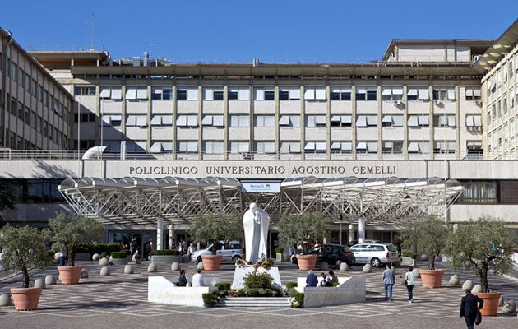
Brain Tumor Group
Fondazione Policlinico Gemelli
Neurosurgery
Prof. Alessandro Olivi
Prof.ssa Liverana Lauretti
Dr. Q. Giorgio D’Alessandris
Dr. Giuseppe M. Della Pepa
Radiation Oncology/Neuro-Oncology
Prof. Mario Balducci
Dr.ssa Silvia Chiesa
Dr. Ciro Mazzarella
Dr. Francesco Beghella Bartoli
Neuroradiology
Prof. Cesare Colosimo
Prof. Giuseppe M. Di Lella
Prof.ssa Simona Gaudino
Neuropathology
Dr. Marco Gessi
quintinogiorgio.dalessandris@policlinicogemelli.it
+39 339 1971409

