Slide 1


Ependimomi intracranici dell’adulto:
Analisi retrospettica clinico-traslazionale e raccolta prospettica AINO
Roberta Rudà
STUDIO RETROSPETTICO AINO
sui gliomi di grado II IDH1/2 wild type
Analisi preliminare della casistica
Roberta Rudà
On behalf of AINO
Spring Meeting
Milano, 27 Maggio 2022

Slide 2
Introduction
Ependymomas are rare tumours, constituting 8% to 10% of brain tumours in children and 1% to 3% of brain tumours in adults.
Tumour location is largely dependent on age, with approximately 90% of pediatric ependymomas occurring intracranially, and 65% of adult tumours occurring in the spinal cord.
The small number of patients included in the studies, the heterogeneity in terms of age and location, as well as the long time period analyzed, explain the lack of evidence-based treatment strategies.

Slide 3
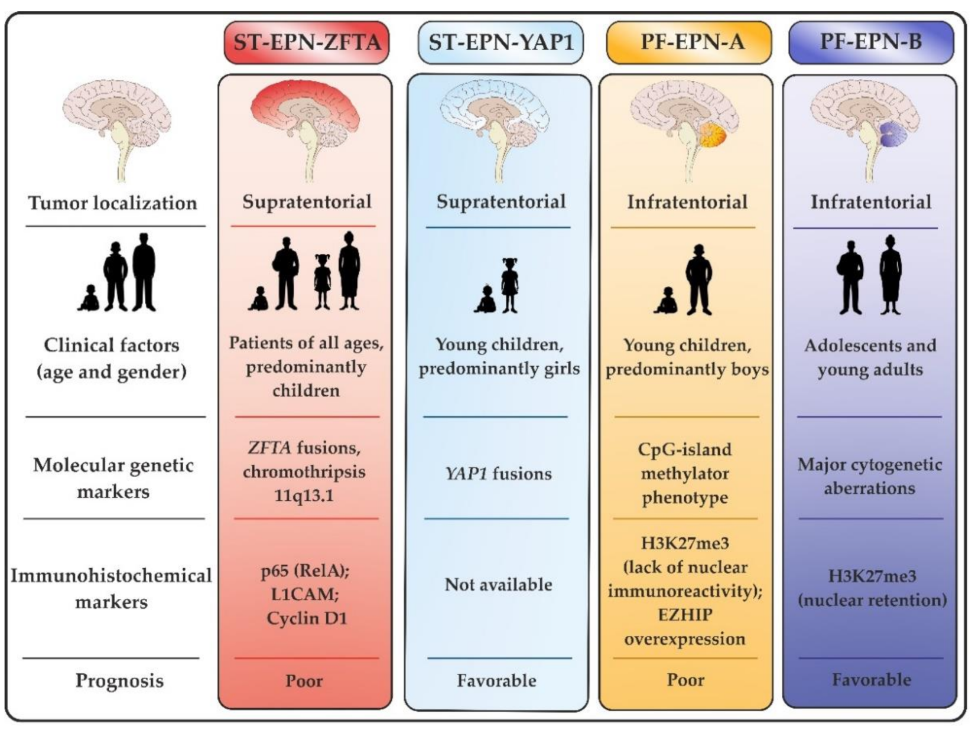
WHO 2021 Classification
The 2021 WHO Classification identifies different molecular subgroups of intracranial supratentorial (ZFTA fusion; YAP1 fusion) and posterior fossa (PFA / PFB) ependymomas, which may show with different clinical features and outcome.
Supratentorial ependymomas ZFTA-fused and posterior fossa ependymomas PFA have been suggested to have a poorer prognosis as compared to YAP1-fused and PFB counterparts.
However, which is the best treatment strategy within different molecular subgroups has not been clarified so far.

Slide 4
Intracranial ependymomas of the adult: outcome and response to treatments across molecular subtypes. A pilot analysis on 42 patients.
Aims of the study
To investigate the frequency of molecular alterations in a population of adult intracranial ependymomas.
To investigate the clinical characteristics, response to treatment, and outcome across different molecular subtypes.
Patients and Methods.
Clinical data of patients ≥18 years with STEs and PFEs were retrospectively collected from 2 Italian Centres (Turin, Treviso).
ZFTA and YAP1 fusions were detected by FISH, while PFA and PFB subtypes were defined by anti-H3K27me3 immunohistochemistry.

Slide 5
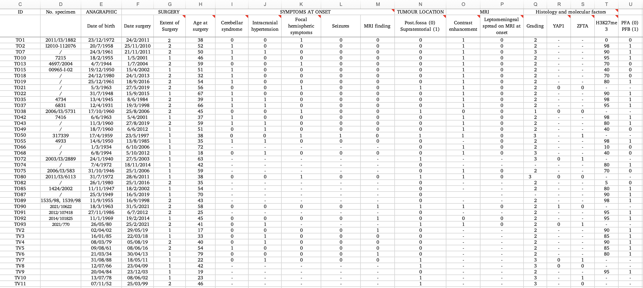
Pilot analysis: data collection (extract from the database sheet).

Slide 6
Study proposal: a Prospective Registry by AINO
Rationale: to expand the retrospective series of the pilot analysis by including data of adults patients with intracranial ependymoma from other Centres.
Main aims of the study
To collect information about clinical characteristics and treatment strategy of adult patients with intracranial ependymomas across different molecular subroups
To identify potential correlation between molecular subroups, response to treatment, and outcome (progression-free survival; overall survival)

Slide 7
Study proposal: a Prospective Registry by AINO
Methods
Data collection: to fill a dedicated database with clinical characteristics at presentation, molecular diagnosis according to 2021 WHO, treatment strategy information (extent of surgery; adjuvant RT and / or CT), MRI response to treatment, survival data.
Molecular analysis: central review of histological / molecular diagnosis for the determination of ZFTA, YAP1, and PFA/B subgroups.

Slide 8
Contacts if you are interested and/or you need more informations please contact
  Dott.ssa Roberta Rudà
  E-mail: rudarob@hotmail.com
  Dott. Francesco Bruno
  E-mail: f.bruno@unito.it
  Polly Graziani
  E-mail: neuro.oncologia.pgraziani@gmail.com

